Slide 1

GOVERNMENT COLLEGE OF ENGG. SRIRANGAM
TIRUCHIRAPPALLI - 12
Department of Computer Science and Engineering CULTURAL AND PILGRIMAGE LOCAL GUIDE APPLICATION
SUPERVISOR
Prof. P. SARANYA, M.E.,
Assistant Professor ,
Government College of Engg. Srirangam,
Tiruchirappalli – 620012.
TEAM MEMBERS
DHAVAMANI P 830120104005
SARAVANAMANI R 830120104024
SATHASIVA PANDI P 830120104310

Slide 2
OVERVIEW
Abstract
Introduction
Problem Statement
Literature Survey
Existing System
Disadvantage of Existing System
Proposed System
Advantage of Proposed System
Technology Stack
System Architecture
Modules
Output
Conclusion
References

Slide 3
ABSTRACT
Even today it is not easy to know about the cultural heritage and spiritual significance of a region .
A quick and informative experience for those who like this app.
Used to learn about visit iconic landmarks, historical sites and religious temple.
It helps to learn about the special events of the day related to the history and tradition of a particular religious.
Local guide to the cultural and spiritual landscape of your destination.

Slide 4
INTRODUCTION
A tourist app helps travellers in exploring a new location or city.
The app provides users with information on local attraction and events, as well as maps, directions and other travel related features.
The app may include features such as current update and special events are shown.

Slide 5
PROBLEM STATEMENT
To provide Spiritual significance of different locations, as well as practical information such as directions and on hours and to provide information about the exact point of destination location is a very useful way for tourists.
The problem statement for a tourist guide app for Tamil Nadu would be to create a user-friendly and comprehensive app that can provide visitors with relevant information about tourist attractions and other important amenities in the state.

Slide 6
Literature Review
TITLE | AUTHOR | JOURNAL NAME | YEAR OF PUBLICATION | DISADVANTAGES
Tourism guide for Tamil Nadu app | P K Jithin, P Prasath, J T Thirukrishna, M Vishnuram | International journal for innovative research in science & technology | 2018 | There is no information about tourist place. Just given google map link.
Tamilnadu Tour app | Nithra | Nithra Tamil labs | 2018 | Some wrong information is there.

Slide 7
EXISTING SYSTEM
A tourist guide application for Tamil Nadu would likely include information about popular tourist destinations in the state, such as historical sites, temples, beaches, and wildlife sanctuaries.
It also includes information about accommodations, restaurants, and local events.
The application might have a GPS-based feature that allows users to navigate to their desired destinations, as well as a search function that allows users to filter destinations by category or location.

Slide 8
DISADVANTAGES OF EXISTING SYSTEM
Provided only the most popular places in Tamilnadu.
Provide only the destination address information.
Most of the applications are not activated in regular updates.

Slide 9
PROPOSED SYSTEM
User Friendly Interface : Ease to use
Location based information : Detect the user’s current location and provide information about nearby tourist attractions.
Personalized Recommendation : Use user data and preferences to offer personalized recommendations for tours other activities.
Historical Information : Facts about the tourist attraction and cities.

Slide 10
ADVANTAGES OF PROPOSED SYSTEM
Personalized Recommendations: These applications can offer personalized recommendations based on the user's preferences, such as suggesting popular tourist spots, local and activities based on their location and interests.
Real-Time Updates: The application can provide real-time updates on any changes in opening hours of attractions.

Slide 11
TECHNOLOGY STACK
Software Requirement:
Operating System : Android 5.0
Language : HTML, CSS, XML and JAVA SCRIPT
Data base : Firebase
IDE : Android Studio
Firebase(Advanced) Java Script
Hardware Requirement:
RAM : 2 GB RAM and more
Processor: Android 5.0 and above
Storage : 8 GB and above

Slide 12
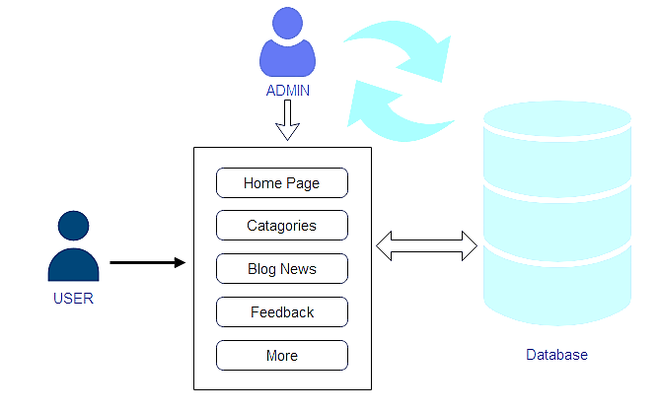
SYSTEM ARCHITECTURE

Slide 13
MODULES
Destination Information Module: This module can provide information about popular tourist destinations in Tamil Nadu, including historical sites, temples, beaches, hill stations, and wildlife sanctuaries.
Events and Festivals Module: This module can provide information about local events and festivals in Tamil Nadu, including cultural and religious celebrations, music and dance performances, and sports events.
Interactive Maps Module: This module can provide interactive maps of Tamil Nadu, which can provide information about the location of tourist destinations
Feedback and Review Module: This module can allow tourists to provide feedback and reviews about the tourist guide application and their experiences in Tamil Nadu.

Slide 14
OUTPUT

Slide 15
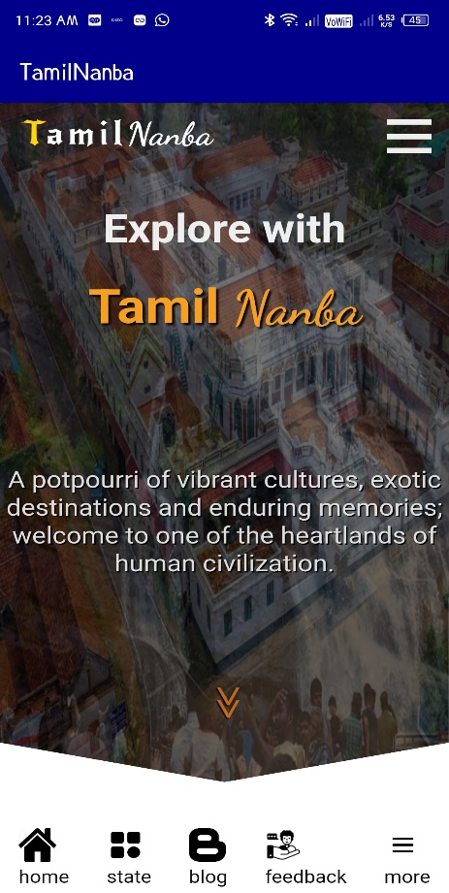

Slide 16
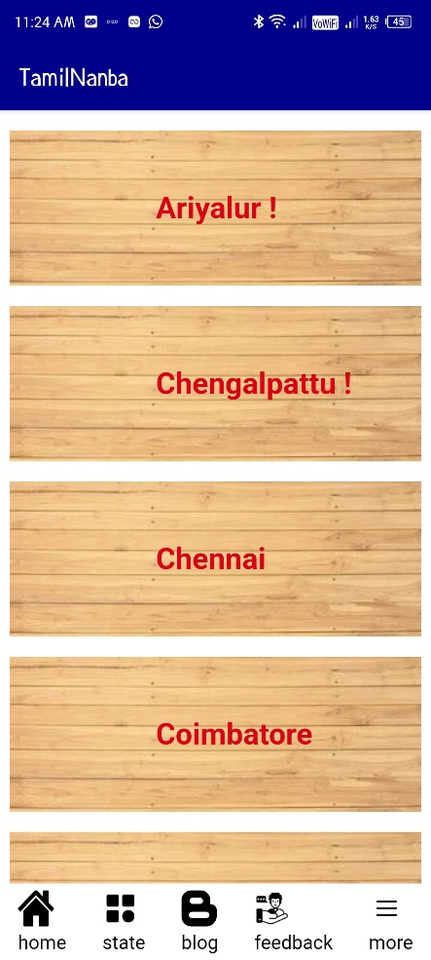

Slide 17
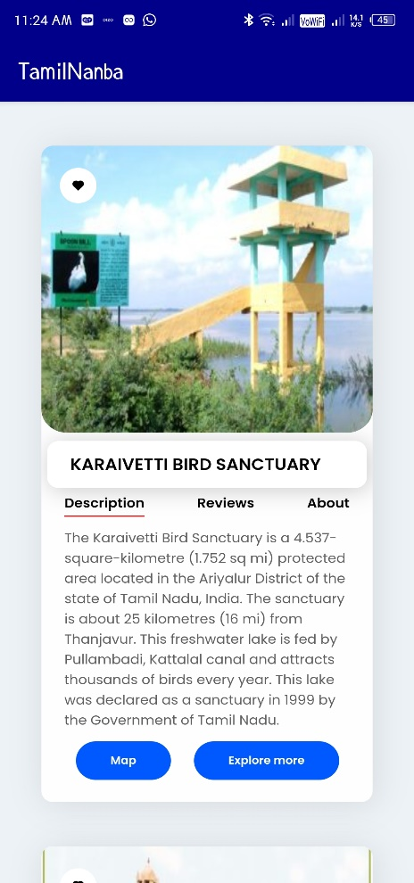

Slide 18
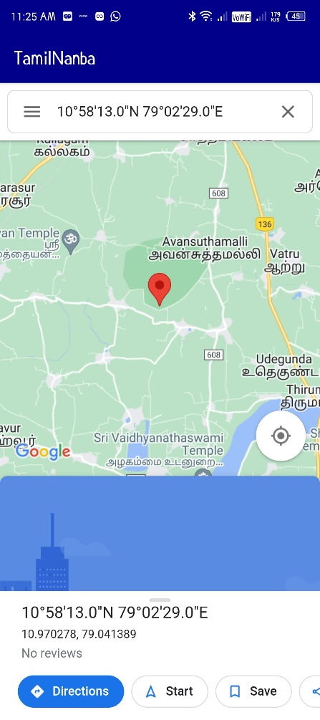

Slide 19
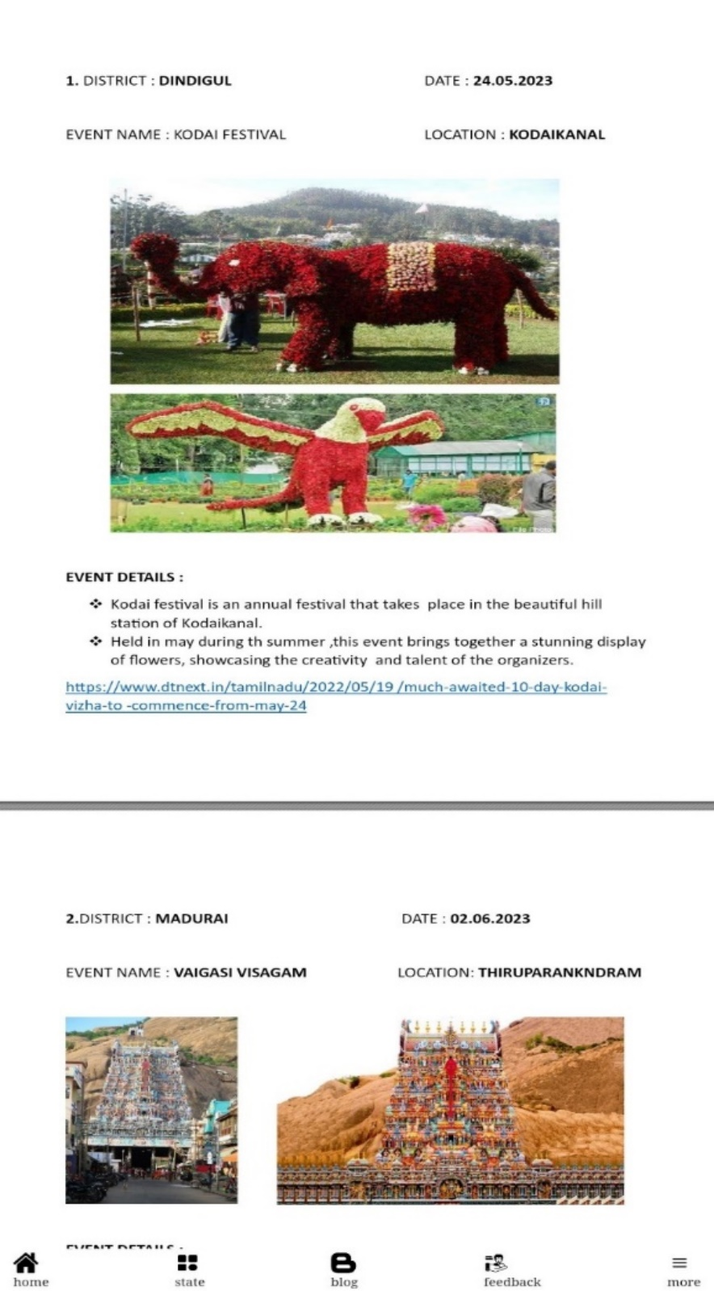

Slide 20
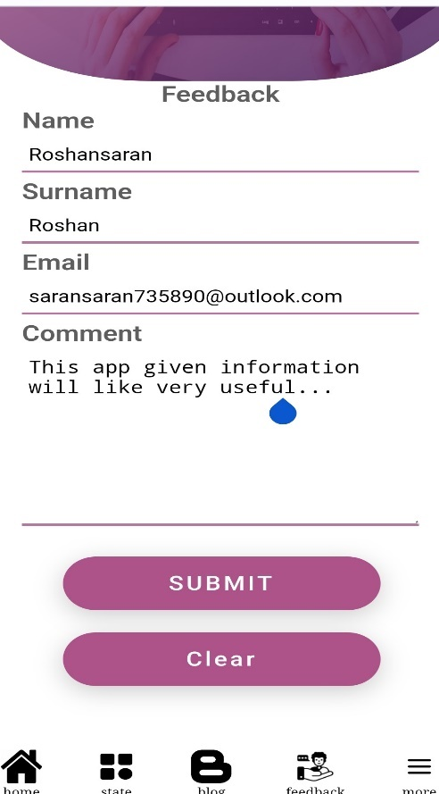

Slide 21
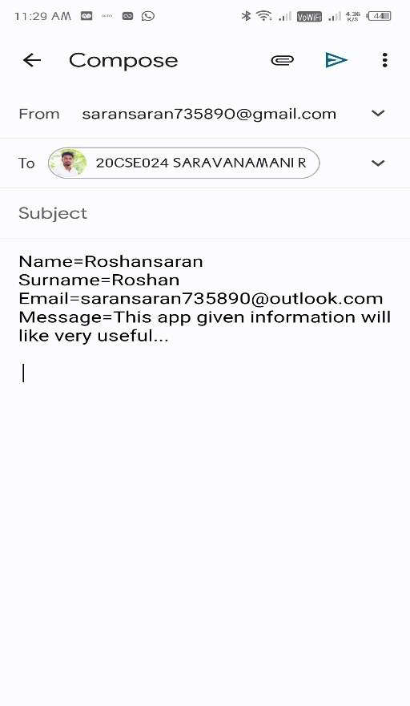

Slide 22
CONCLUSION
This app offers a easily accessible and interactive guide provided by CPLGA for any region.
This application provides an user-friendly interface and which includes regular updates.
It is applicable for all level of peoples who can explore and experience the cultural and spiritual heritage of the world.

Slide 23
REFERENCES
1. Ministry of tourism was introduced by Shripad Naik in1967 In Headquarters in
New Delhi.
Reference link: https://tourism.gov.in/
2. Tamil Nadu Tour app launched in 2018 developed by Nita Tamil Labs.
3. Tourism Guide for Tamil Nadu Application Developed by International Journal for
Innovative Research Science and Technology Launched in 2018.

Slide 24
QUERIES

Slide 25
THANK YOU

